Slide 1
Sustainable communities, sustainable ecosystems – what’s the connection? Presentation to Sustainable Living Armidale 3 November 2011
Richard Stayner
Institute for Rural Futures, UNE

Slide 2
Sustainability – meaning depends on context
A sustainable (pick a word!) - community, business, sporting club, lifestyle, environment, future, planet (!)
It doesn’t mean stability
Neither ecosystems nor communities are stable – they are both ‘complex adaptive systems’
Sustainable growth (a contradiction?)
Sustainable development:
‘Development that meets the needs of the present without reducing the ability of future generations to meet their own needs’
(Brundtland, 1987 Our common future)
So it’s something to do with the time – the future

Slide 3
Conflicts between community and natural resource sustainability may be increasing
Forestry communities
Murray Darling Basin Plan
Coal seam gas – (conflict within communities as well)
Coastal fisheries
What are the lessons from these?

Slide 4
Interest in rural community sustainability – a response to the ‘dying towns disease’
Has attracted much local effort, research, & policy in the past couple of decades
What has threatened their sustainability?
Changes in agriculture and other primary industries; changes in businesses serving the farm sector; economies of size in businesses and services; greater ease of movement between places. (Stayner, 2005)
In Australia, natural resource problems have only infrequently been the main source of community decline (exception: mining communities).

Slide 5
Is Bundarra ‘sustainable’?
A slow decline due to long-term economy-wide and local forces
How has the community adapted? In what way is it resilient?
Notes:
Clearly, it has not been able to sustain its former role and importance to its residents – but are the functions it still serves sustainable?

Slide 6
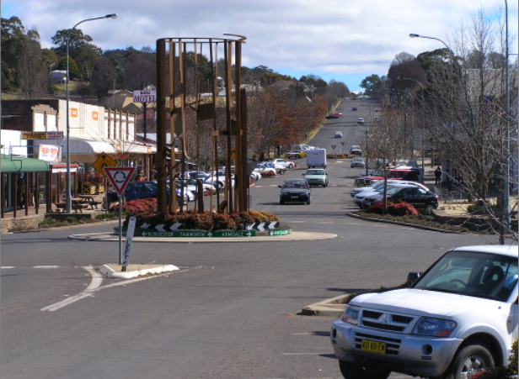
How about Walcha?

Slide 7
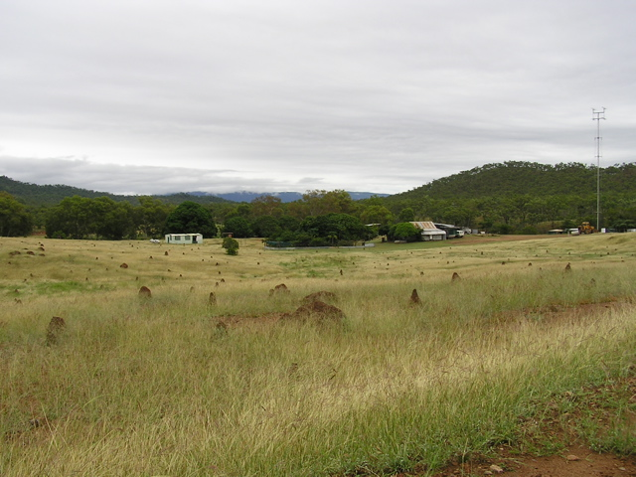
Thornborough (Qld) was not sustainable – 8,000 people once lived here
Notes:
Thornborough was the main administrative centre for inland North Queensland in the 19th century,
having a school, hospital, court buildings and local government offices.
There were 19 hotels, one of which - Wah Lee’s Canton Hotel - still remains as a shed on Thornborough Station.
In the 1880s, the population was 8,000, with another 6,000 in surrounding areas, mainly mining for gold, including 2,000 Chinese.
Today the population of Thornborough is two people, who run a cattle property over the former mining area.
The next cattle property to the north, Mt Mulligan, site of an abandoned coal mining town, is developing eco-tourism –
the third cycle of economic development.

Slide 8
Nor was Kanowna, W.A. 12,000 people once lived here. This was the railway station, which had hourly trains to Kalgoorlie, 18 km away.
There is still a mine here - but no town.
Notes:
The town and railway have gone, but the mine hasn’t.
The ghost town of Kanowna is 18 km east of Kalgoorlie. It had 16 hotels, two breweries and an hourly train service to Kalgoorlie.
It’s now a paddock of prickly bushes and the odd bit of concrete.
The picture shows the remains of the railway station platform where the hourly train left.
Modern mining technology can reach deposits that were beyond the old mining methods,
and a new and very large open-cut mine at Kanowna now operates.
Despite this, the population of Kanowna is still zero - the workforce all commute from Kalgoorlie.

Slide 9
What about Ravenswood, Qld (circa 1907)?

Slide 10
Ravenswood, 2007.
How quickly did Ravenswood change?
How much economic and social loss occurred?
How much disadvantage remains for its residents?
Notes:
If the adjustment was spread over a long enough time, the pain / waste may have been modest.
If these trends are still occurring elsewhere, and if comparable changes occur as a result of, inter alia, climate change, what are the economic efficiency and equity reasons for intervening to halt or offset them?
What economic and social ‘externalities’ are being caused by the continuing adjustment of rural regions?
That is, who and where - other than the people and places moving and declining - are being affected?
Metropolitan congestion? Higher carbon use per unit of economic activity?

Slide 11
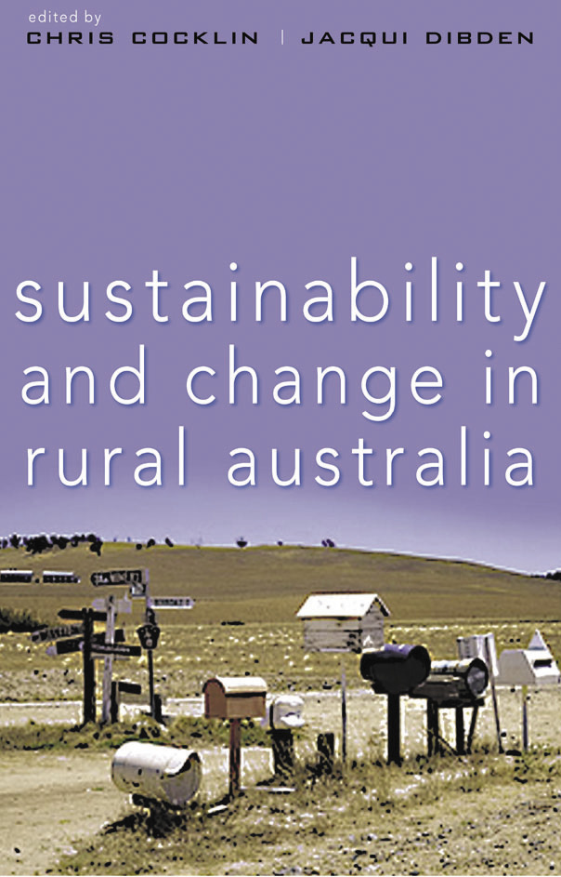
The ingredients of community sustainability
Built capital
People
Networks
Natural resources
Financial capital (savings)
They are all different kinds of capital.
Human capital, social capital and natural capital

Slide 12
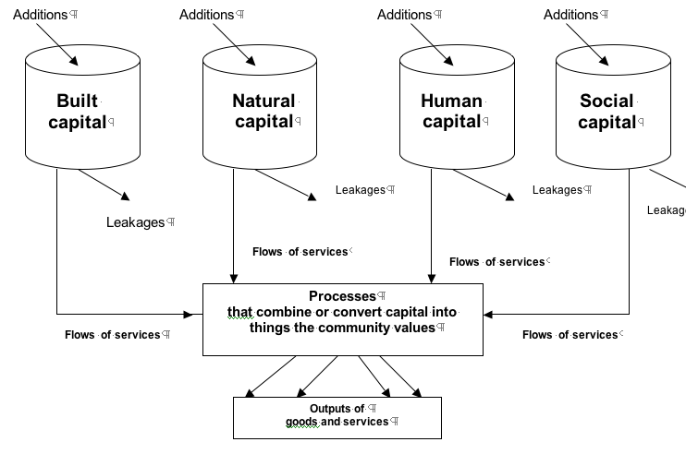
How do communities sustain themselves?
Notes:
Importance of imports of new capital stocks, and exports

Slide 13
From sustainability to resilience
Communities are continually responding to pressure or shock.
The concept of resilience - originally applied to ecosystems - is increasingly being applied to communities (and a lot of other things!)
Again, different meanings (Maguire & Cartwright, 2008)
Resilience as stability: buffer capacity
Resilience as recovery: bouncing back
Resilience as transformation: creativity
Do economic and social diversity enhance community resilience?
Notes:
There is a respectable body of work on ecological resilience

Slide 14
In a recent research project, we studied and visited 6 towns
Blackall, Qld
Longreach, Qld
Merredin, WA
Beverley, WA
Inverell
Walcha

Slide 15
Blackall
Shocks: Move from beef to sheep (wild dog problem); rail closure; amalgamation of councils; loss of services and newspaper.
Responses: Value and display their history (wool scour); diversify into the arts - Heartland Festival; public sculpture; community newspaper.
Lessons: Resilience without growth; active but ‘thin’ social capital; role of non-local networks.

Slide 16
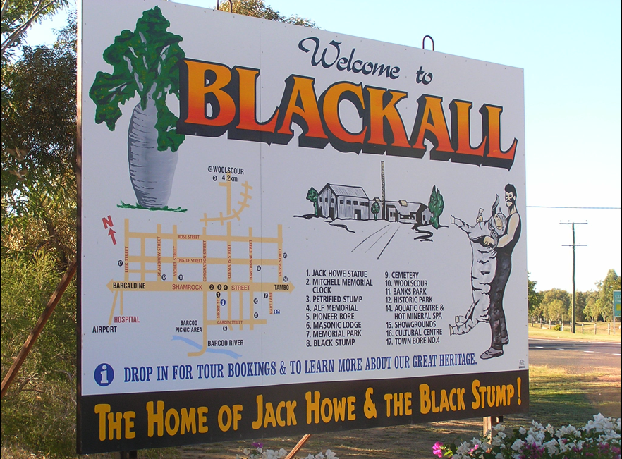

Slide 17
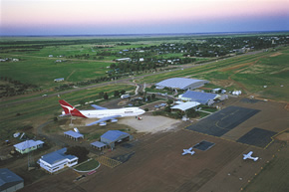
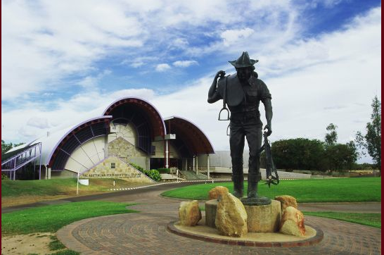
Longreach
Qantas Founders
Outback Museum
Stockman’s
Hall of Fame
Notes:
Lessons:
capitalising on the opportunities presented by ‘grey nomad’ tourism - an ‘export’ industry for the region
Importance of human and social capital networks with metropolitan regions

Slide 18
Merredin
Stresses: Low and declining rainfall, salinity, out-migration of young people.
Responses: China Southern Flying College, Community Recreation Centre, CBD redevelopment …
Lessons: Importance of replacing some of the out-migration with in-migrants of early-career age who have the skills, experience and motivation to contribute to the community.

Slide 19
Beverley
Stresses: Proximity to Perth and other centres (Northam, York), ageing population.
Responses: A variety of small ones.
Lessons: Lack of critical mass; can Beverley continue to provide the basic needs of residents?

Slide 20
Inverell
Stresses: Drought; dominant employer is vulnerable to climatic risk; closure of North West Electricity and pet-food factory.
Responses: Strong strategic management by Council; focus on aged services, tourism, arts; acceptance of social diversity (Bruderhof community)
Lessons: Size helps a lot; crucial role of social capital - strong sense of shared purpose and fates.

Slide 21
Walcha
Stresses: Drought; decline of wool industry, proximity to Armidale; closure of timber mill.
Responses: Capturing through traffic; public art; substitution of natural resource based activity; dairying; plantation forestry.
Lessons: Role of human and social capital; re-creation of community identity.

Slide 22
Important natural resources - complementary inputs to community wellbeing
Blackall: artesian water (spa and domestic)
Longreach: Town Common, Desert Channels (e.g., entry to town)
Merredin: salinity, air space, wind power, receptive to carbon farming.
Beverley: changing peri-urban land-use
Inverell: Copeton Dam
Walcha: Regional Forest Agreement; wilderness; reliable rainfall.

Slide 23
Overall …
Resilience did not always mean growth
Diversity and ‘openness’ were important
Connections with - and attachments to - space and place are changing
Whatever the source of stress, and whatever the response, community resilience leans heavily on human and social capital.

Slide 24
Human capital issues
Loss of young people
Loss of families when children reach high-school age
Importance of attracting in-migrants with the right sorts of skills, experience and motivations
Such people look for quality social, recreational and environmental amenities.
Notes:
Whatever the source of stress, the resilience response depends on the characteristics of human and social capital.
They can substitute (to some extent) for the lack of other forms of capital

Slide 25
Social capital issues
Diverse kinds of social capital, and roles for it
It grows through use …
… but it is becoming very thinly-stretched and ‘burns out’ in many rural communities
It is important to include young people - it will be their community one day.
How to balance diversity and inclusion?
Notes:
Success can be cumulative - creates & nurtures
Created by past actions and nurtured by success - gives the community its sense of ‘efficacy’ and resilience

Slide 26
Natural resource limits are (finally) being recognised
Stocks of natural capital have been declining, and their services degrading, for some time
Other forms of capital have been substituted for natural capital (‘weak’ sustainability)
But for some natural capital assets, a ‘strong’ sustainability rule is needed: maintain at least a given level of natural capital.
Determining that level - the ‘sustainable use limit’ (Namoi groundwater, MDB surface water, catch quotas in fisheries) is often difficult.

Slide 27
Resilience in natural systems
Knowledge of the behaviour of complex natural systems is usually incomplete.
Exceeding natural resource thresholds can trigger catastrophic and irreversible decline
The costs of irreversible change can be very high
This requires a ‘precautionary principle’
Socio-economic systems also have thresholds and irreversibilities, but human systems may be more adaptable than ecosystems (debatable?)

Slide 28
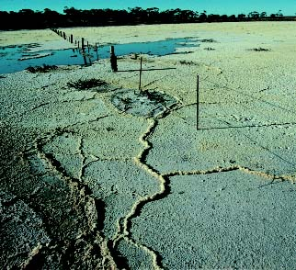
The effects of exceeding natural resource limits are often delayed and remote - e.g., soil salinity

Slide 29
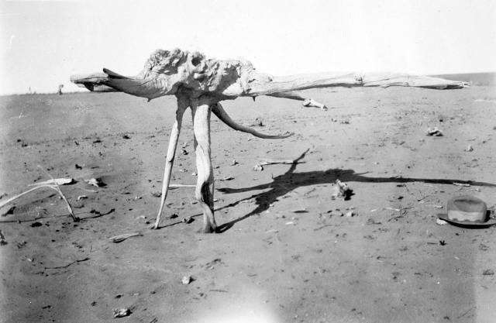
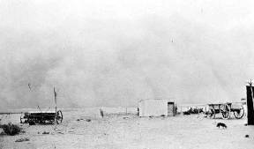
… but they can be near and soon eg, Soldier Settlement in the Mallee
Notes:
See also: Wagga Wagga

Slide 30
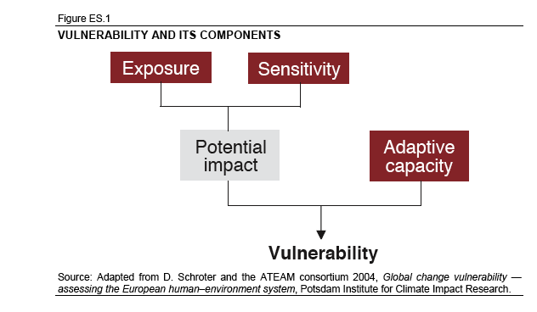
A general conceptual framework (from the climate change literature - Allen Consulting Group, 2005)
Notes:
When applied to availability of water in the MDB: ‘Exposure’ (broadly) is the scale of the impacting event (say, the relative reduction in water availability);
‘Sensitivity’ includes both the relative dependence of irrigated agriculture on water
and, through trade and other linkages, the dependence of other parts of the local economy
Other consumptive users - urban, stock & domestic - should also be included.
‘Potential impact’ is the joint effect of Exposure and Sensitivity, and could be estimated by economic modelling, for example.
‘Adaptive capacity’ acknowledges the resources and processes that are brought to bear by communities in responding to these potential and initial actual impacts.
‘Vulnerability’ is the residual impact on communities after allowing for the adaptive response of the community.
‘Resilience’ can be thought of as the inverse of vulnerability - to the extent that a community can ameliorate the potential impacts of exposure/sensitivity, it would be judged to be resilient.

Slide 31
Policy is trying to catch up
But scientists do not have ‘full information’ - ecosystems and their interactions with humans are complex.
Scientific understanding may be ‘contested’
Human values are also contested:
‘jobs to people,’ vs ‘people to jobs’
What value should be put on ‘attachment to place’? Mobility vs community cohesion
NSW Natural Resources Commission Target 12:
Natural resource decisions [should] contribute to improving or maintaining economic sustainability and social well-being.
CMA Catchment Action Plans are required to take socio-economic interactions into account

Slide 32
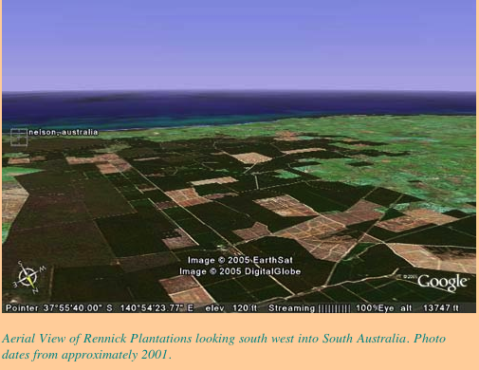
Policies may have unintended consequences
Notes:
These forests have imposed a significant negative externality on adjacent farm land.
They absorb so much rainfall that infiltration, and hence recharge of groundwater aquifers, has declined.
This has lowered the water table, and increased the cost of pumping groundwater for nearby farmers.
And plantations put more pressure on communities, through loss of population.

Slide 33
The decay of a natural resource system can be sudden and steep
The ‘pain’ (damage) of socio-economic adjustment to natural resource policy is lower if it is spread over a long time.
Policy should therefore try to anticipate the future effects e.g., climate change.
It is difficult to estimate and communicate the future benefits and costs of action vs inaction.

Slide 34
The MDB Plan saga
Irrigation was once seen as the solution to low (or unreliable) rainfall
It hasn’t worked out that way in the Murray Darling Basin: why?
What will happen to dependent communities if / when sustainable diversion limits are imposed?
How should affected communities be helped to manage their adjustment?

Slide 35
Helping communities manage natural resource limits – more than money
Information - better understanding (science)
Institutions - more trusting relationships (‘politics’)
Identity - build on the need for belonging (social capital)
Incentives - people’s desire to improve their wellbeing (economics)
Mark van Vugt (New Scientist, 25 August 2009)
We can also help communities to:
Imagine a different (but acceptable) future

